Slide 1

Crop Guard :A Multi-Stage Disease Detection System along with Disease Classification for plants Using Machine Learning On Leaf Images

Slide 2

TEAM MEMBERS
J.Aruna Bharathi
Ch.Manikanta Reddy
Ch.Sahithi
K.Samitha

Slide 3
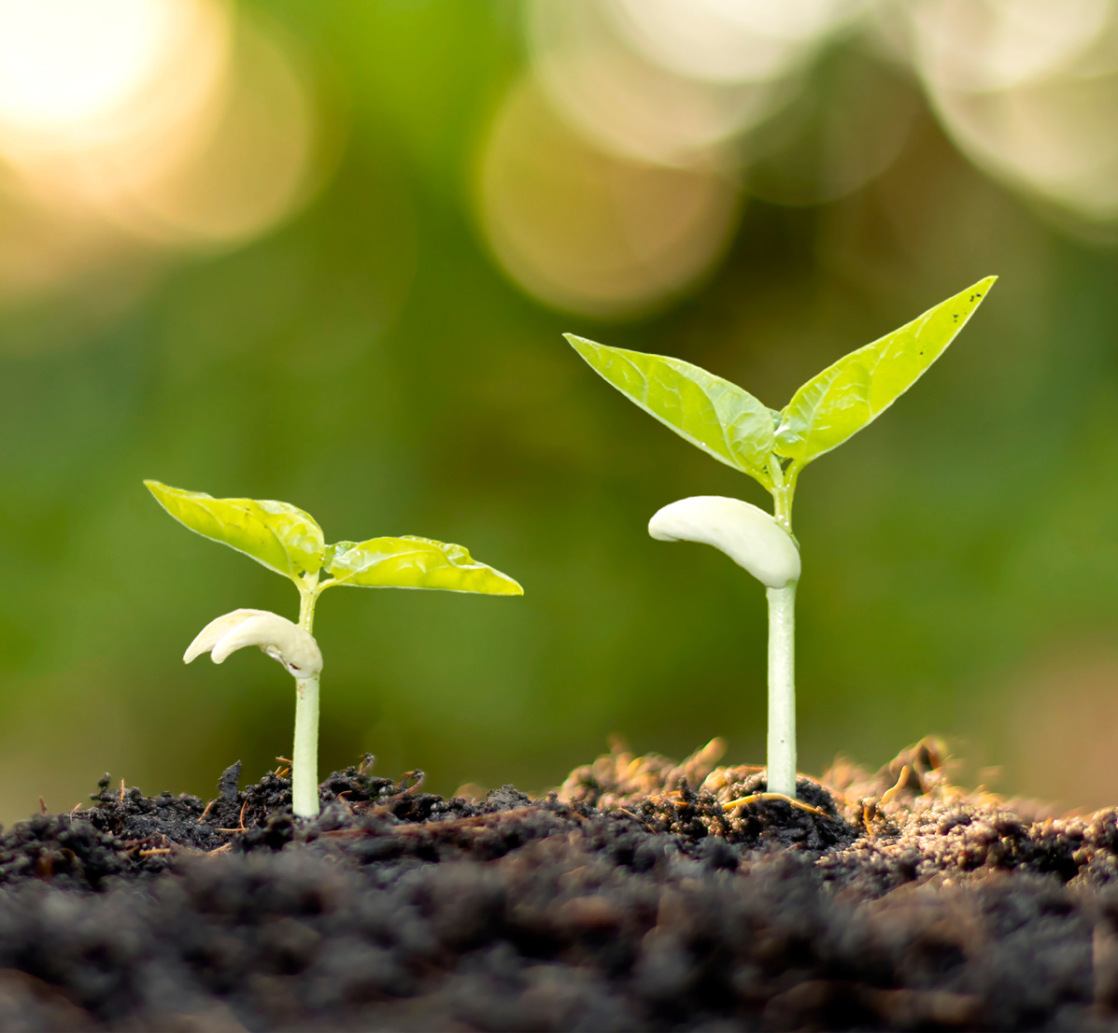
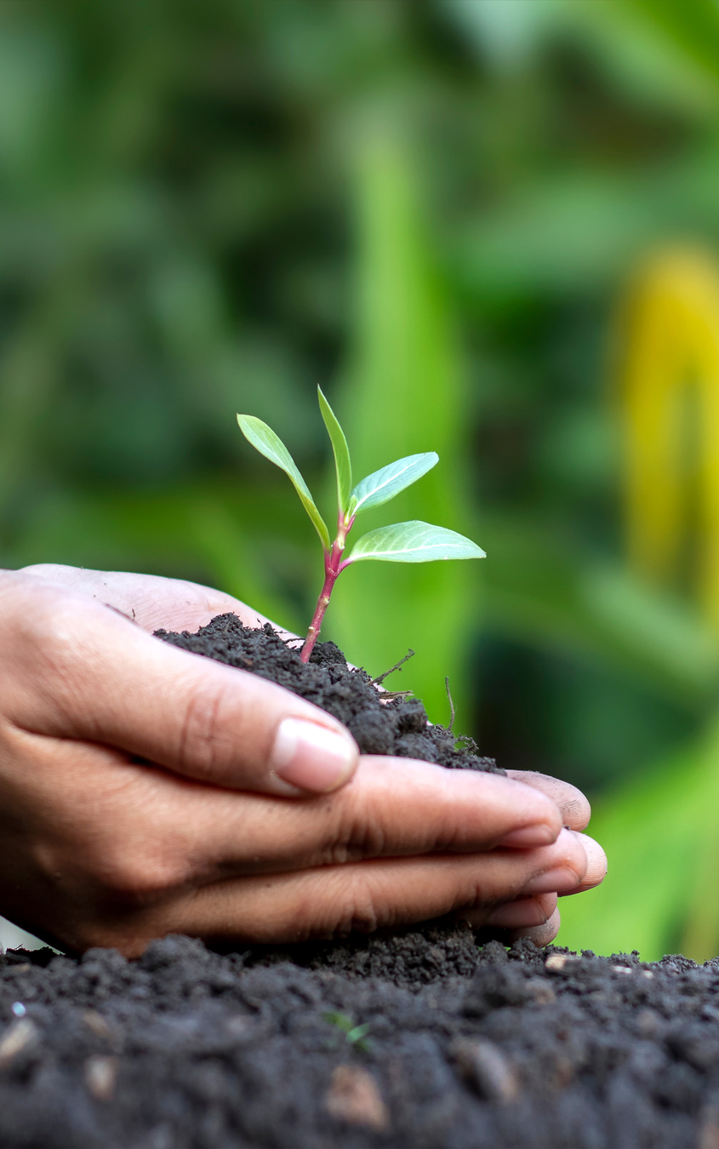
UNVEILING THE JOURNEY OF CROP DISEASE AND LEVEL
OF DETECTION
Introduction
Challenges
Data Exploration
Methodology
Feature engineering
Model Training
Source code Repository
Results
Conclusion
Future Work

Slide 4

INTRODUCTION
Agriculture is undergoing a transformative revolution with rapid technological advancements.
The “CropGuard" project employs machine learning and computer vision to diagnose and categorize plant diseases based on leaf images.
Its focus is to provide crucial insights into crop health, enabling timely interventions for optimized yield and sustainable farming practices.
OBJECTIVES
Primary objective: Develop a robust machine learning model for analyzing leaf images and identifying diseases.
Advanced classification: Model goes beyond binary detection, classifying diseases into distinct stages.
Multi-stage classification benefits: Enables assessment of disease severity for informed decision-making.
Impact: Empowers farmers and agricultural experts with comprehensive insights for better management strategies.

Slide 5

CHALLENGES
Farmers often lack expertise to identify specific leaf diseases affecting their crops accurately.
Determining the severity level of a disease on leaves poses a challenge for farmers.
Lack of precise disease information hinders targeted interventions, leading to potentially ineffective treatments.
Inability to promptly address diseases results in yield losses and impacts overall agricultural productivity.
Relying on visual inspection alone is subjective and time consuming, especially as farm sizes increase.
Farmers may resort to generic treatments, leading to unnecessary use of resources such as pesticides.
Limited knowledge increases the risk of misdiagnosing diseases, exacerbating the impact on crops.
Farmers may lack access to real-time information on emerging diseases, hindering proactive disease management.

Slide 6
DATA EXPLORATION
Comprehensive Dataset Analysis:
Thoroughly analyze the dataset, examining diverse attributes such as leaf images, disease types,
and security levels.
Distribution Understanding:
Understand the distribution of diseases and severity levels to ensure a representative and balanced
dataset training.
Feature Identification:
Identify relevant features in the dataset crucial for accurate disease classification and severity
grading.
Data Quality Check:
Conduct a quality check to address issues such as missing values, outliers, and inconsistencies in the
dataset.
Visualization for Insights:
Utilize visualization techniques to gain insights into patterns, correlations, and characteristics of the
leaf disease data.
Exploratory Data Analysis (EDA):
Perform EDA to uncover key trends, relationships, and potential challenges that may influence the
model training process.
SAVE ENVIRONTMENT
OUR VISION

Slide 7

METHODOLOGY
Obtain images of leaves from the crops.
Resize, normalize, and preprocess the captured leaf images.
Extract relevant characteristics from the preprocessed images.
Identify the type of disease affecting the leaves.
Determine the severity level of the identified disease (healthy,powdery, rust).
Visualize the results, potentially using tools like confusion matrices.

Slide 8
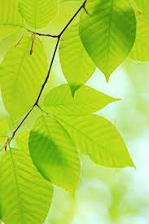
KEY FEATURES
Leaf Image Analysis: The model takes leaf images as input, utilizing advanced computer vision techniques to extract relevant features and patterns.
Disease Detection: Employing machine learning algorithms, CropGuard accurately detects the presence of diseases in plants, contributing to early diagnosis.
Multi-Stage Classification: Beyond binary identification, the model classifies diseases into different stages, offering a nuanced understanding of the severity of the infestation.
User-Friendly Interface: CropGuard incorporates a user-friendly interface, making it accessible to farmers and agricultural professionals, fostering seamless integration into existing agricultural practices.

Slide 9
STEP BY STEP FLOWCHART
STEP 1
STEP 2
Capture Leaf Images
Preprocess Images
STEP 4
STEP 3
Feature Extraction
Severity Level Detection
STEP 5
STEP 6
Disease Classification
Data Visualization

Slide 10
SOURCE CODE REPOSITORY
Source Code link:
Link

Slide 11
FEATURE ENGINEERING
Extracting geometric features like leaf area and perimeter for distinguishing healthy and diseased leaves.
Employ machine learning algorithms to utilize texture features (e.g., coarseness, contrast) with machine learning models for nuanced pattern recognition.
Train models to recognize distinctive patterns in vein structures as indicative of various diseases.
Utilize statistical features with machine learning to capture and learn from pixel intensity distributions.
Implement machine learning algorithms to process and interpret the fractal dimension for disease characterization.
Train models to recognize edges and contours, enhancing the identification of irregularities associated with diseases.
Leverage machine learning for color space transformations to emphasize disease-related color information effectively.
Train models to recognize local texture patterns using Local Binary Patterns for disease detection.
Types of Detection:
Binary Classification (Healthy vs. Diseased):
Utilize machine learning algorithms to classify
leaves into healthy or diseased categories.
Multiclass Classification (Disease Type Identification):
Implement machine learning models to categorize
leaves into specific disease types.
Severity Grading (Level of Disease):
Train models to assess the severity levels of diseases, providing a more nuanced understanding for intervention

Slide 12
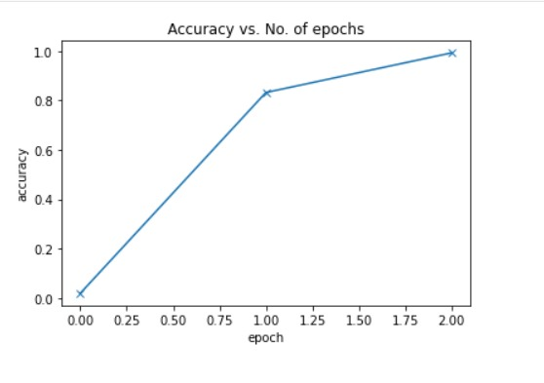
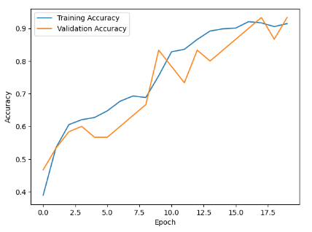
MODEL TRAINING
Gather labeled dataset, ensuring balance. Preprocess and divide into training, validation, and testing sets, maintaining randomness.
Choosing CNN model on dataset characteristics and complexity of plant leaf disease detection.
Initialize model with random weights. Prepare for learning process in subsequent training iterations with backpropagation.
Fine-tune hyperparameters iteratively (e.g., learning rate) based on validation performance, optimizing the model's learning process.
Assess model performance on test set using metrics like accuracy, precision, recall, and F1-score for effective evaluation.
Save trained model for deployment, document the entire training process, and consider future refinements for continuous improvement.

Slide 13
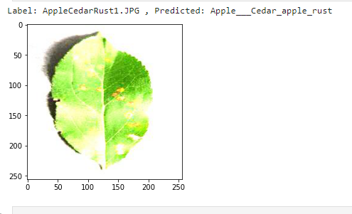
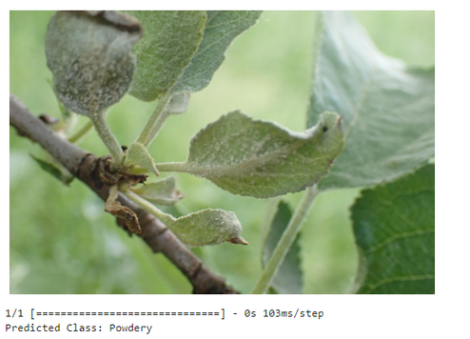
RESULTS
The trained model demonstrated impressive accuracy, outperforming traditional methods, and exhibited high precision in correctly identifying diseased and healthy leaves.
Successful categorization of various disease types showcased the model's robustness in distinguishing between different plant leaf diseases, providing actionable insights for farmers.
The model accurately graded disease severity levels, offering a nuanced understanding crucial for targeted and timely interventions, ultimately minimizing crop losses.
Test Accuracy:
for level of disease detection-91.6667%
for type of disease prediction-97.56%

Slide 14
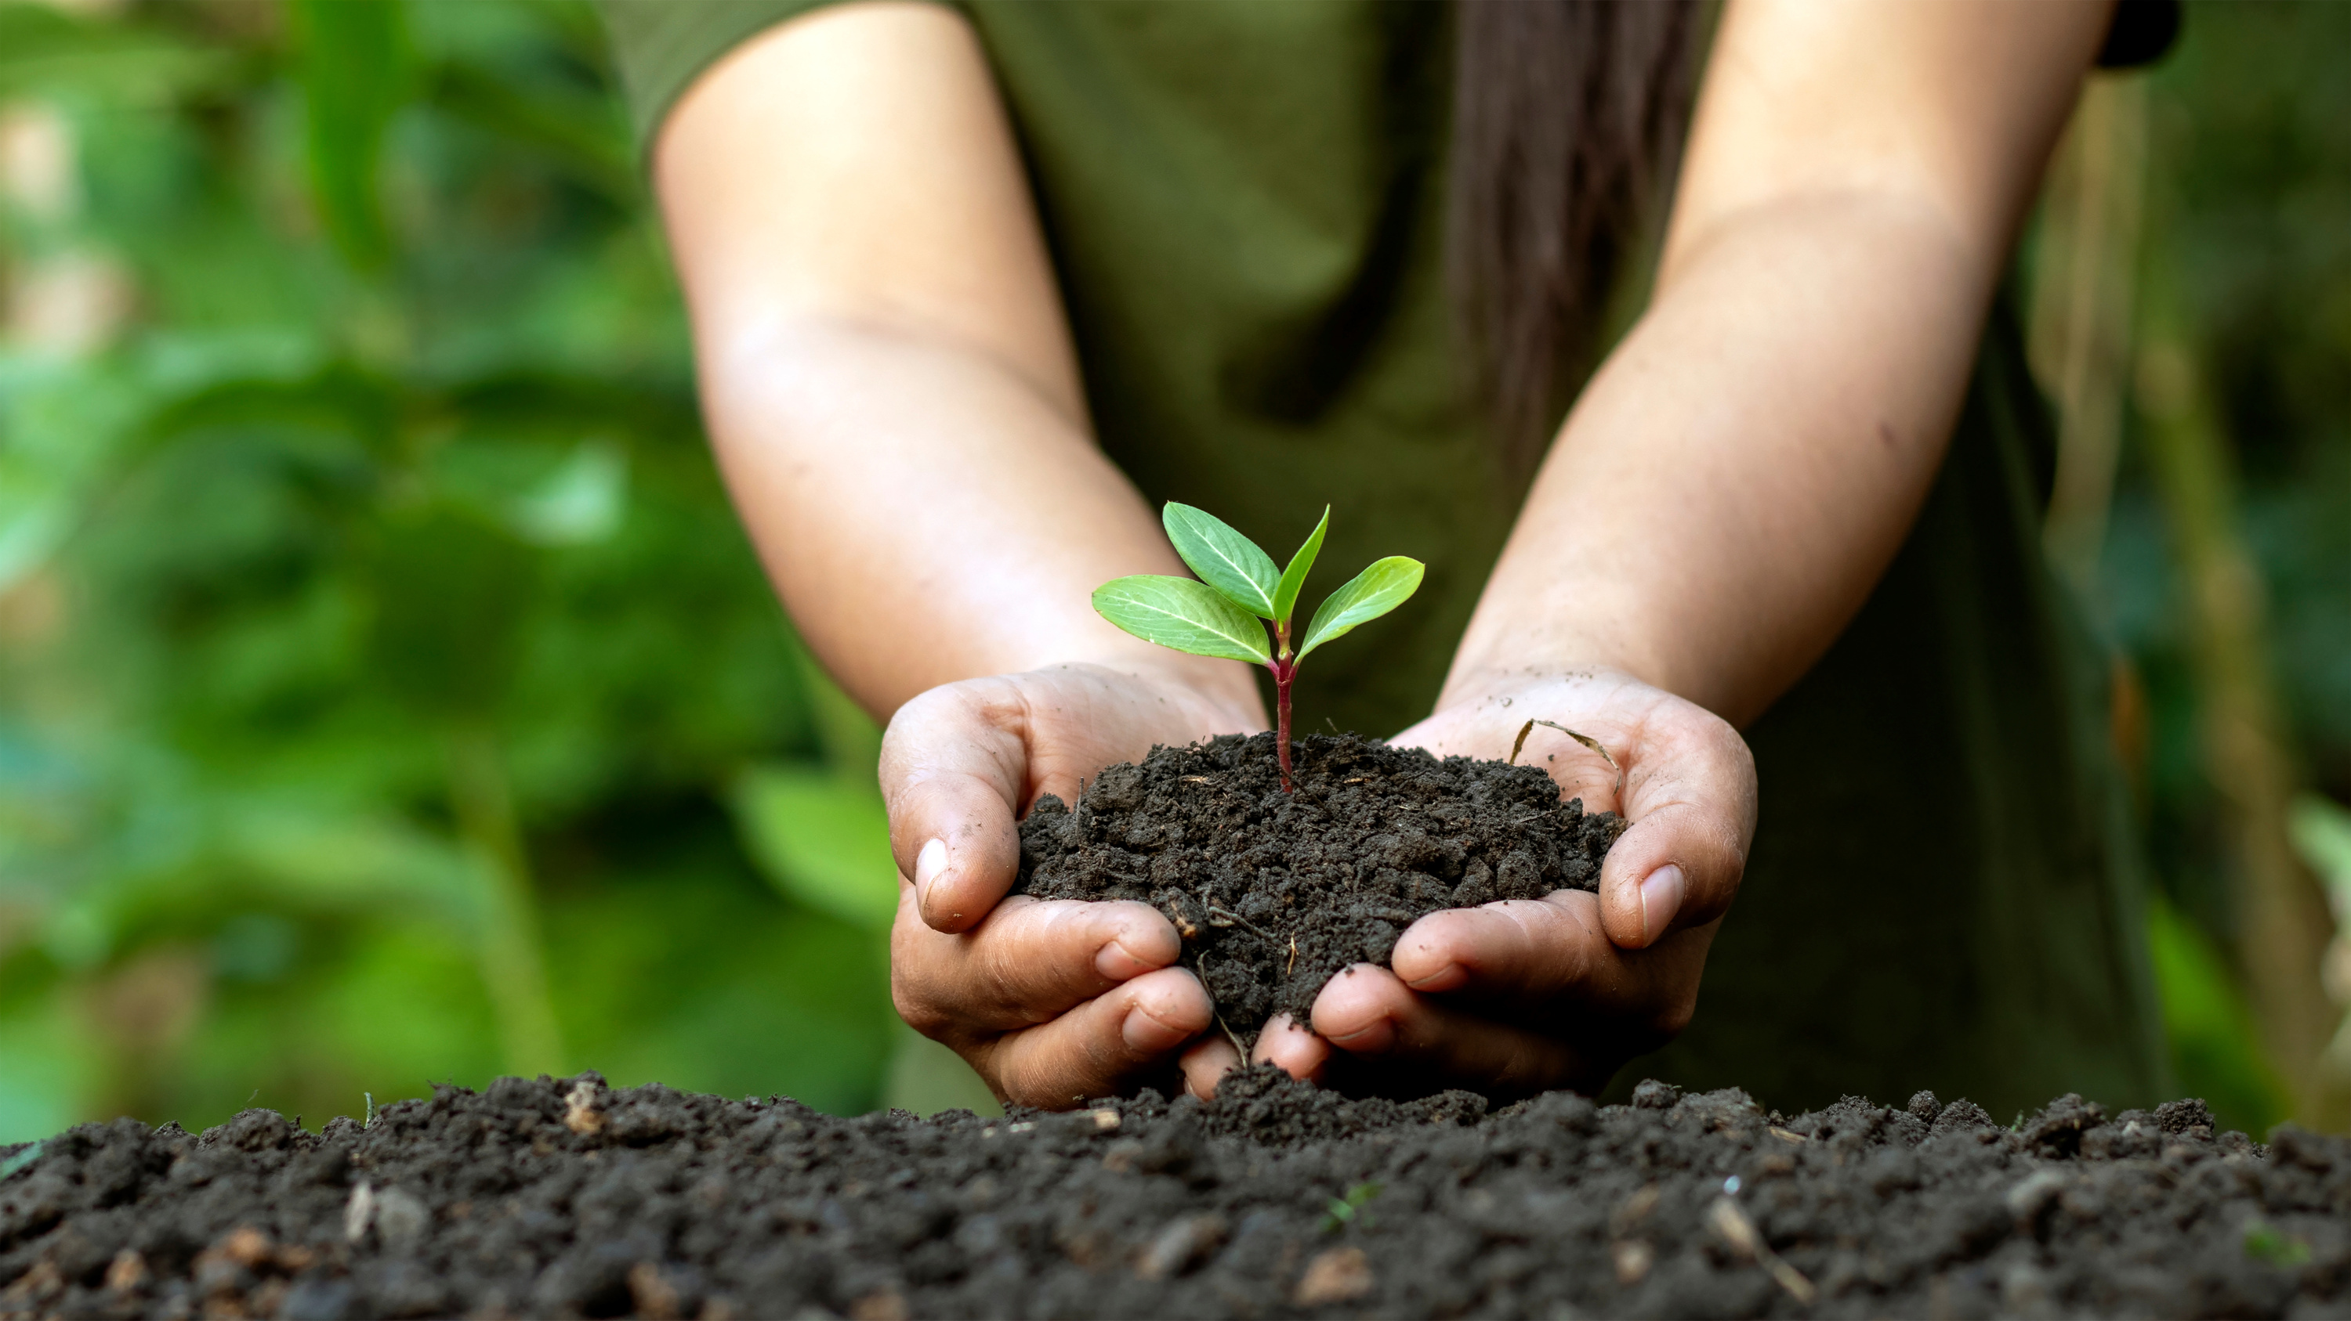

CONCLUSION
Innovation beacon: LeafGuard project stands at the crossroads of agriculture and technology as a symbol of pioneering innovation.
Reshaping diagnostics: Promises to transform plant disease diagnostics significantly.
Revolutionary approach: Aims to revolutionize crop management practices.
Impact: Expected to bring about a paradigm shift in how we perceive and handle crop health and disease management.

Slide 15

THANK YOU

